Slide 1




Cybersecurity Data Science
Best Practices from the Field
Scott Allen Mongeau
scott.mongeau@sas.com
Cybersecurity Data Scientist – SAS Institute
Lecturer / PhD candidate – Nyenrode Business University
@SARK7 #CSDS2020 #FloCon19
This presentation is non-commercial, for educational purposes only
All opinions herein are my own, not those of my employer
No rights claimed or implied to 3rd party materials
Copyright © 2019 Scott Mongeau All rights reserved.

Slide 2


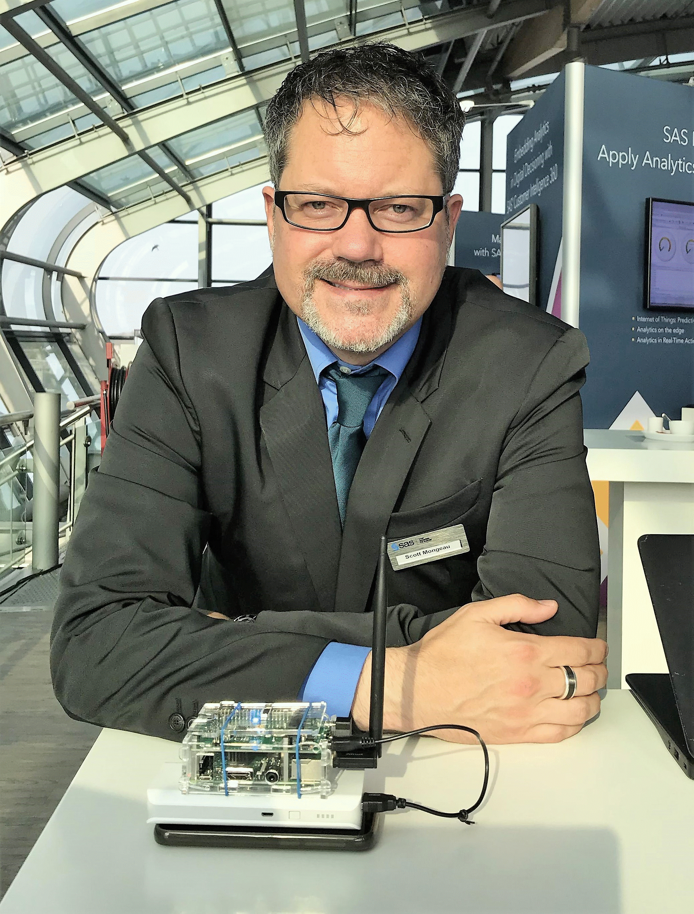
INTRODUCTION
Cybersecurity Data Science practitioner – SAS Institute
Lecturer / PhD candidate – Nyenrode Business University
Qualitative research
43 global cybersecurity data scientists
Key challenges and best practices
Organizational & methodological guidance
Book early 2020 #CSDS2020
‘Cybersecurity Data Science: Prescribed Best Practices’

Slide 3
Research Motivation: Genesis in Six Memes

Slide 4

Three Year Genesis of This Talk
FloCon 2017 – San Diego
Interest in data analytics percolates
But… cautious: ‘I’ll know it when I see it’
Labeled for non-commercial reuse

Slide 5
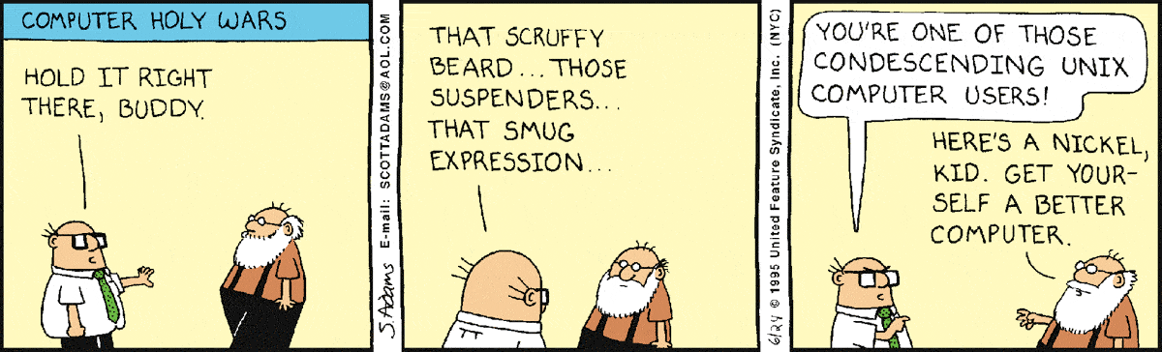
2017: “THE CAUTIOUS TRADITIONALISTS”

Slide 6

Three Year Genesis of This Talk
FloCon 2017 – San Diego
Interest in data analytics percolates
But… cautious: ‘I’ll know it when I see it’
FloCon 2018 – Tucson
Spike in analytics and machine learning cases
But… questions emerge: ‘How do we get from here to there?’
Labeled for non-commercial reuse Wikipedia Commons

Slide 7




2018: “THE DATA REVOUTIONARIES”

Slide 8

2018: SAY ‘DATA SCIENCE’…
ONE… MORE… TIME!

Slide 9

Three Year Genesis of This Talk
FloCon 2017 – San Diego
Interest in analytics percolates
But…: ‘I’ll know it when I see it’
FloCon 2018 – Tucson
Spike in analytics and ML cases
But…: ‘How do we get there?’
FloCon 2019 – New Orleans
Deafening market / vendor buzz
But, caveats abound: ‘Many are drowning in data lakes’
Labeled for non-commercial reuse Wikipedia Commons

Slide 10
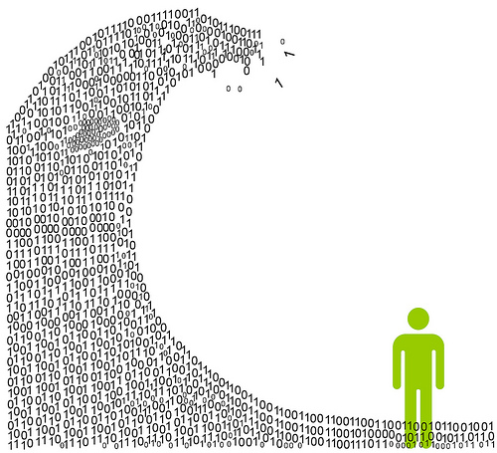
2019: Drowning in Data Lakes
Vendor Hype

Slide 11

2019: ONE DOES NOT SIMPLY…
“PUSH A DEEP LEARNING MODEL TO PRODUCTION”

Slide 12
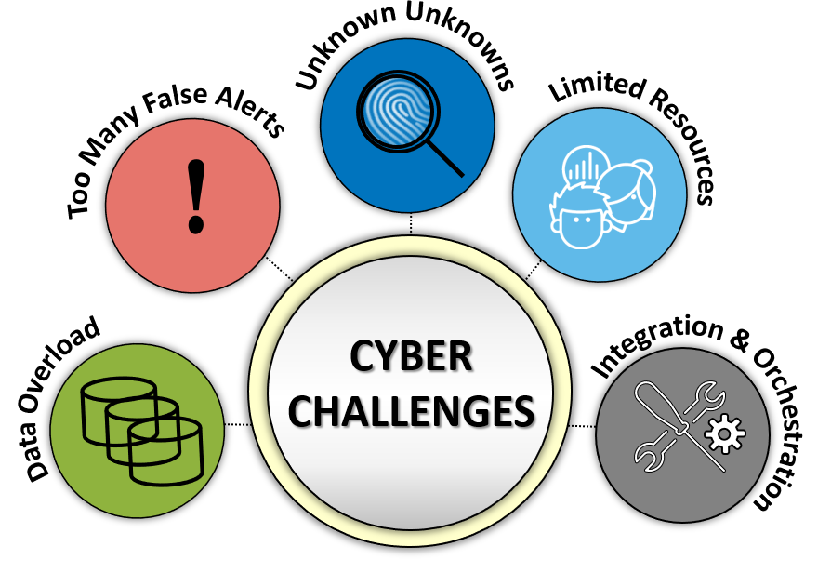
2019
But…
substantial
issues
grow

Slide 13
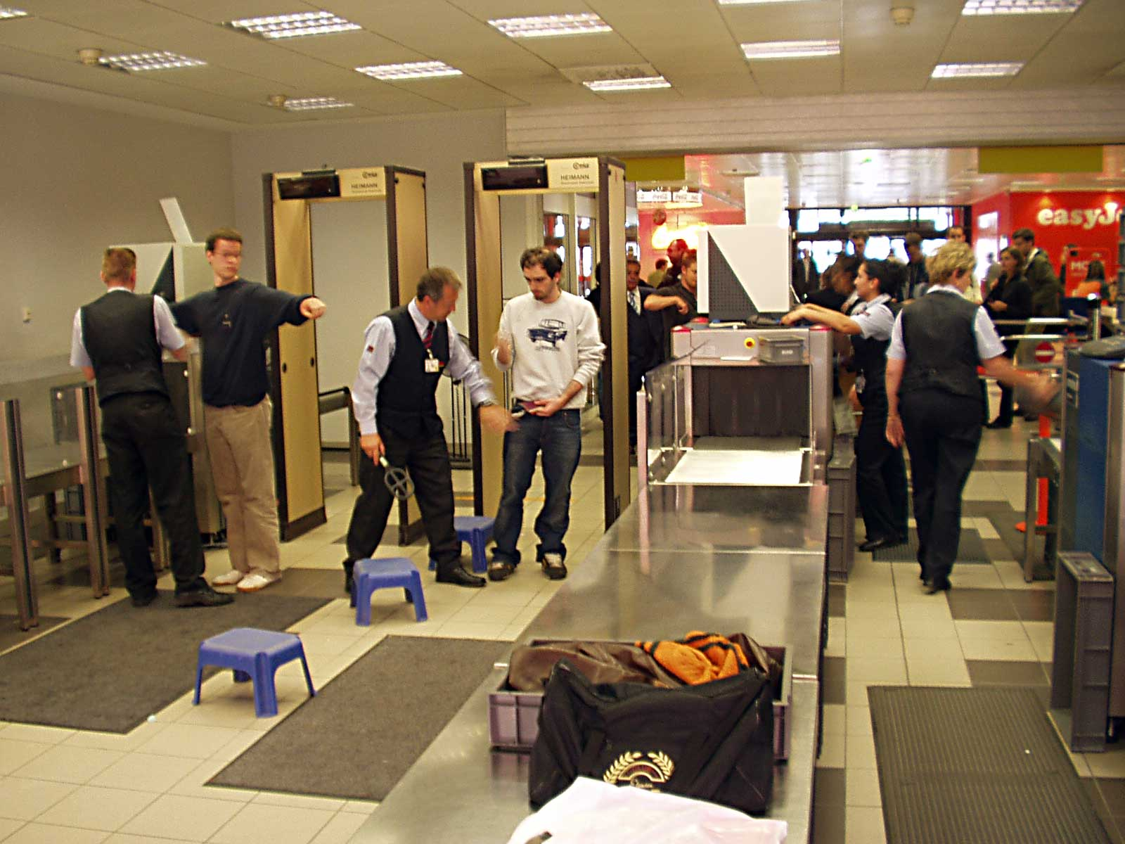
2019: Reactive militarization

Slide 14
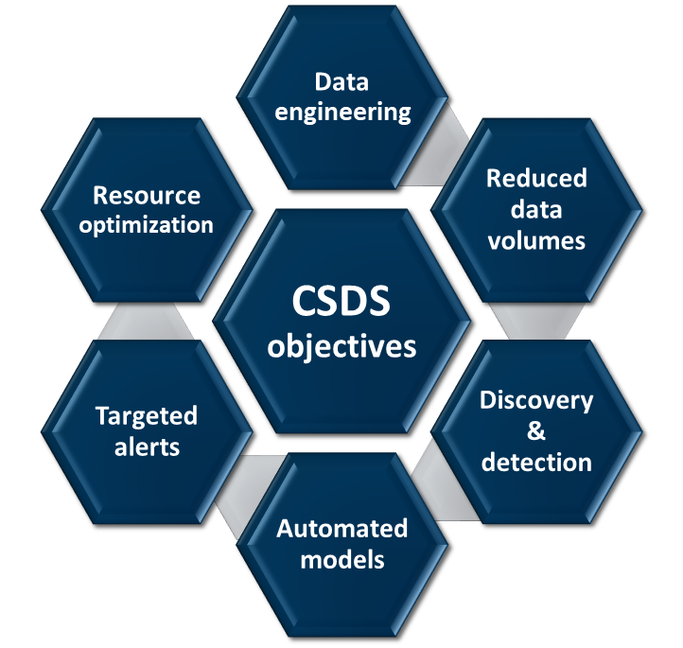
2019
CSDS
Cyber
Security
Data
Science
DATA SCIENCE
METHODS
CYBERSECURITY
GOALS

Slide 15
2019
CSDS
Cyber
Security
Data
Science
Taking stock
“Data scientists and practitioners can talk past each other.”
Rapid emergence
Early stages of professionalization
Affected by maturity of ‘data science’ more generally

Slide 16
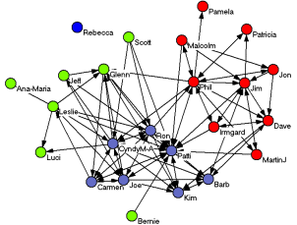
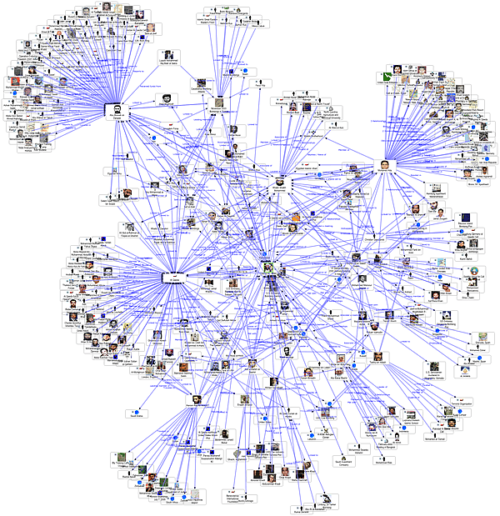
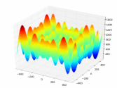
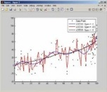
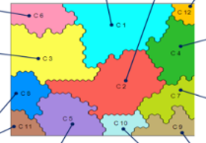
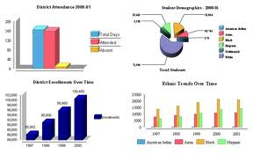

Data Science in 30 Seconds…
Data visualization
SEMANTIC
Understanding Patterns
PRESCRIPTIVE
?
HIGH
Optimizing Systems
PREDICTIVE
Network Context & Meaning
Identifying
Factors & Causes
DIAGNOSTIC
Forecasting & Probabilities
VALUE
DESCRIPTIVE
DATA ENGINEEERING
Business Intelligence
LOW
OVERHEAD
HIGH
See YouTube lectures: https://bit.ly/SS9rCT

Slide 17
CSDS Interview Research What Type of Data Science is CSDS?

Slide 18
Participants - Sample
43 participants + 130 years collective CSDS experience (3 yr mean)
Linked-In search
‘cybersecurity’ + (‘data scientist’ or ‘analytics’)
~350 professionals globally
Direct outreach
Follow-on referrals
Gating to exclude ‘ceremonial CSDS’
i.e. sales, recruiting, marketing, technology strategists

Slide 19
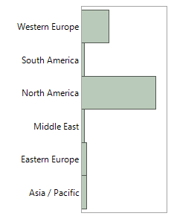
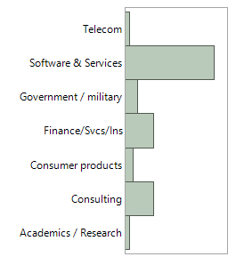
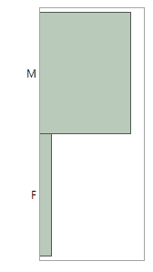
Demographic Profile (n=43)
Current Region
Current Industry
Gender
25% (n=11) relocated from native region
19% (n=8) relocated to US specifically
12% (n=5) relocated from Asia to US

Slide 20
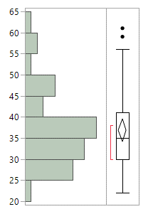
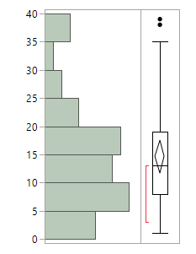
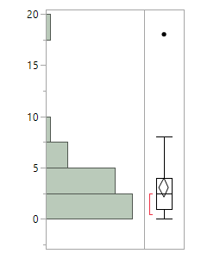
Demographic Profile (n=43)
Age*
# Yrs Employed*
# Yrs CSDS*
* Estimates inferred from LinkedIn profile data

Slide 21
Interview Questions and Analysis 43 Cybersecurity Data Scientists (Dis-)Agree…

Slide 22
CSDS Practitioner Interview Research
Qualitative: Open Response 30 Minute Interviews
ENTRY: How did you become involved in domain?
What TRENDS are emerging?
What are perceived central CHALLENGES?
What are key BEST PRACTICES?
METHODS: Borrowing from adjacent domains?
THREATS: Trends on the adversarial side?

Slide 23
Methodology: Interview Topic Labeling (CODING)
Inductive Extrapolation and Deductive Refinement
Text analytics processing
Engine: SAS Contextual Analysis
Natural Language Processing (NLP)
Latent Semantic Indexing (LSI)
Singular Value Decomposition (SVD)
Topic extraction
Agglomerative => multi-doc
Concept clustering
Divisive => unique doc
Content analytics extrapolated themes
Domain literature review
Practitioner review
Key topics (codes)
‘Coding’ of processed interview transcripts

Slide 24
CSDS Objectives - Conceptual Model for Responses
Framing and Relationships Amongst Topics
TRENDS
THREATS
ADJACENT DOMAINS
BEST PRACTICES
CHALLENGES

Slide 25
Threats & Adjacent Domains CSDS Professional Perspectives

Slide 26
THREATS: 13 Adversarial Trends
Internal threats
Inherent vulnerabilities
White hat tools (i.e. PEN testing) often quickly end up being repurposed for black hat purposes…
Reverse engineering detection
Automated attacks increasing
Exploiting new tech vectors
Adversarial objectives evolve to optimize economic risk-reward
Social engineering
Ransomware-as-a-service
Crypto-jacking
Much disagreement, from indignant disbelief to notion of manifest destiny
Continual adaptation
State actors => machine learning
Time-to-detection / dwell time
i.e. Reverse engineering and confusing / tricking ML models (seeding false data)… Although a ‘hot topic’ in academic research, few indications of incidents.
Industry-specific attacks
Adversarial ML

Slide 27
METHODS: 8 Influential Adjacent Domains
QUOTE: “It is almost a crime how little we learn from the fraud domain being as they have been at it for almost a century.”
Social & behavioral sciences
Fraud / forensics / criminology
QUOTE: “As networks and devices become increasingly complex and intertwined, they begin to resemble organic systems and act in biological ways.”
Medical, epidemiological, ecological
Enterprise risk management
QUOTE: “Whereas cybersecurity seeks to safeguard, it isn’t going to get very far without quantifying risks and impacts.”
Network graph analytics
NLP & semantic engineering
Forecasting / time-series analysis
QUOTE: “Still a work in progress, and one does need to step over the hype, but there are some early indications that deep learning can be quite efficacious if one is handling immense amounts of labeled data.”
Computer vision / deep learning

Slide 28
CHALLENGES Perceived CSDS Gaps

Slide 29







Challenges: 12 Topics
ORGANIZATION
Confusion
Marketing hype
Regulatory uncertainty
Few resources
PROCESS
Inherent costs
Decision uncertainty
False alerts volume
Scientific process?
TECHNOLOGY
Data preparation / quality
Own infrastructure & shadow IT?
Normal vs. anomalous?
Lack of labeled incidents

Slide 30
Challenges: 12 Topics => 5 Themes*
* Utilizing exploratory factor analysis (extraction of latent factors)
Leadership has ‘lost the plot’
Uncertainty: nature of threats, what is being protected, how to react
Can’t do it all!
Expansive domain: not cost effective to cover everything in house
Between a rock and a hard place…
Rules-based approaches failing, but alternate approaches overhyped
Scientific contextualists
Need to improve representation of environment & tracking of events
Data cleansing: ‘the ugly stepchild’
Critical underinvestment in data engineering to stage analytics

Slide 31
Best Practices Perceived CSDS Treatments

Slide 32
Best Practices: 26 Topics => 8 Themes*
* Utilizing exploratory factor analysis (extraction of latent factors)
ORGANIZATION
Management-driven change
Training & program governance
PROCESS
Organizational process engineering
Structured risk quantification
Focused scientific processes
TECHNOLOGY
Data engineering practices~
Ontologies & normalization
Architecture-driven solutions

Slide 33
Key Guidance CSDS Gap Prescriptions

Slide 34
Key Prescribed Treatments: Correlation Between Factors
Challenge Themes | Best Practice Themes
1. Leadership has ‘lost the plot’ | Management-driven change Training & program governance
2. Can’t do it all! | Organizational process engineering Focused scientific processes
3. Between a rock and a hard place… (limits of rules vs. hype) | Architecture-driven solutions Ontologies & normalization
4. Scientific contextualists | Training & program governance Data engineering practices
5. Data cleansing: ‘the ugly stepchild’ | Management-driven change Training & program governance Structured risk quantification Focused scientific processes Data engineering practices Ontologies & normalization

Slide 35








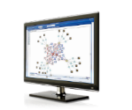



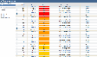
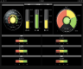




Organization: Interdisciplinary Collaboration
Data Engineering
Advanced Analytics
Triage / Validate
Remediate
Diagnostics & patterns
Establishing baselines
Predictive modelling
Anomaly detection
Behavioral
insights
?
CYBER RISK ANALYTICS PROCESS
Data Engineer
DATA
ENGINEER
Data Scientist
Scientist
INVESTIGATOR
CASE MGMT
Infosec Response
Cyber Investigator
RECURSIVE FEEDBACK
Notes:
KYC, Device recognition and Credit check are not part of the Fraud Framework
KYC/CDD can be provided but involves additional SAS products (AML)
Device recognition data can also be supported if required

Slide 36
Organization: Interdisciplinary Collaboration
Security Experts
Data Scientists
Data Engineers
MGMT
Collaborate in process re-engineering
Collaborate in establishing model context
Admit limits of signatures
Architect exploration and detection processes
Collaborative model building
Model transparency
De-escalate “AI hype cycle”
Decision & ownership clarity
Training & team building
Orchestrate cross-functional collaboration (incentives)
Call “AI = automation” bluff
Core data ‘pipeline’ processing
Facilitate processes / quality
Call “data lake = strategy” bluff

Slide 37
People - Process - Technology Management of Information System

Slide 38
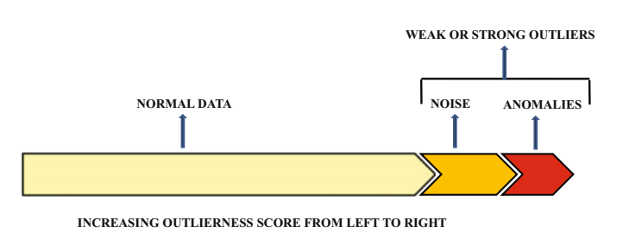







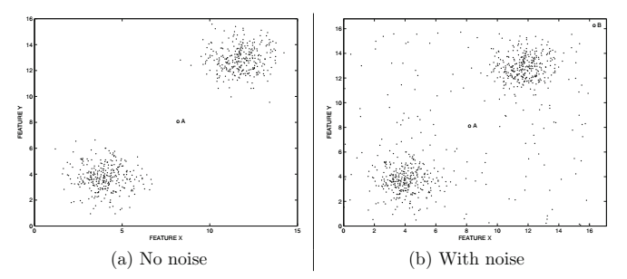





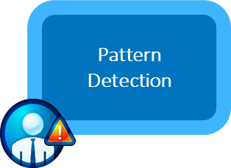
People: Anomaly Detection - Simply Complex
Identifying targeted anomalies amongst an ocean of noise…
PROBLEM FRAMING
EVALUATE & MONITOR RESULTS
DATA
PREPARATION
TARGETED
ALERTS
MODEL DEPLOYMENT
DATA EXPLORATION
MODEL VALIDATION
TRANSFORM & SELECT
MODEL BUILDING
SOURCE
Aggarwal, Charu C. (2017). “Outlier Analysis: Second Edition”. Springer International Publishing AG.

Slide 39
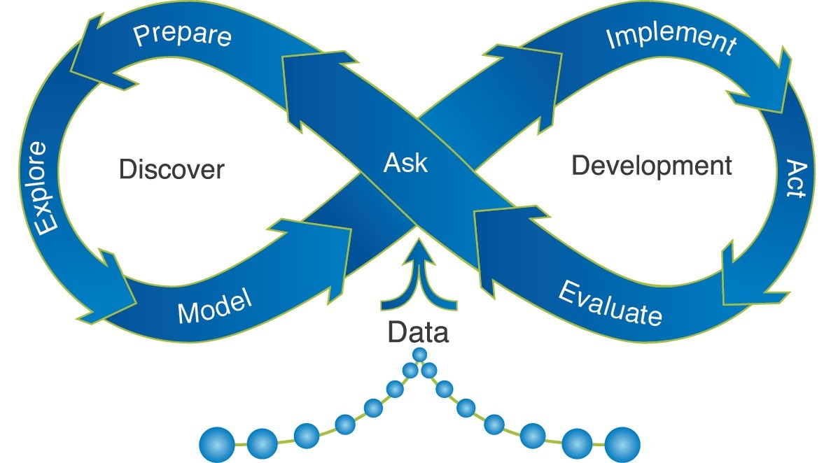
Process: Analytics Life Cycle
Raw Data
Feature Selection
Features
Feature Engineering
Modeling
Insights
SAS: ‘Managing the Analytics Life Cycle for Decisions at Scale’

Slide 40
Technology: Architect Exploratory & Detection Platforms*
Functional Architectural Segmentation
Exploratory ‘big data’ repository
Operationally focused detection
Feature engineering
i.e. selection, refinement, binning, correlations
Canonical ontology / schemas
Analytical models
Descriptive
Unsupervised
Analytical models
Semi-supervised
Human-in-the-loop
Reinforcement
Analytical models
Statistical
Supervised
* Runs counter to the industry vendor stance of store ‘all-the-data-all-the-time’

Slide 41
Summary

Slide 42

Cybersecurity Data Science (CSDS)
Process of Professionalization: a work in progress
Named professionals
Set of methods and techniques
Standards, best practices
Training programs
Certifications
Academic degree programs
Focused research journals
Formal sub-specialization
Specialist
Researcher
Primary Care
Surgeon
Diagnostician
Emergency Care

Slide 43

Thank You! Interested to participate? scott.mongeau@sas.com
Scott Mongeau
Cybersecurity
Data Scientist
+31 68 370 3097
(Netherlands GMT+1)

Slide 44
REFERENCES

Slide 45
REFERENCES
Aggarwal, C. (2013). “Outlier Analysis.” Springer. http://www.springer.com/la/book/9781461463955
Harris, H., Murphy, S., and Vaisman, M. (2013). “Analyzing the Analyzers.” O’Reilly Media. Available at https://www.oreilly.com/data/free/analyzing-the-analyzers.csp
Kirchhoff, C., Upton, D., and Winnefeld, Jr., Admiral J. A. (2015 October 7). “Defending Your Networks: Lessons from the Pentagon.” Harvard Business Review. Available at https://hbr.org/webinar/2015/10/defending-your-networks-lessons-from-the-pentagon
Mongeau, S. (2018). “Cybersecurity Data Science (CSDS).” SCTR7.com. https://sctr7.com/2018/12/03/cybersecurity-data-science-csds-how-not-to-drown-in-your-cyber-data-lake/
Mongeau, S. (2017). “Cybersecurity Big Data Overload?” SCTR7.com. https://sctr7.com/2017/10/22/cybersecurity-big-data-overload/
Ponemon Institute. (2017). “When Seconds Count: How Security Analytics Improves Cybersecurity Defenses.” Available at https://www.sas.com/en_us/whitepapers/ponemon-how-security-analytics-improves-cybersecurity-defenses-108679.html
SANS Institute. (2015). “2015 Analytics and Intelligence Survey.” Available at https://www.sas.com/en_us/whitepapers/sans-analytics-intelligence-survey-108031.html
SANS Institute. (2016). “Using Analytics to Predict Future Attacks and Breaches.” Available at https://www.sas.com/en_us/whitepapers/sans-using-analytics-to-predict-future-attacks-breaches-108130.html
SAS Institute. (2016). “Managing the Analytical Life Cycle for Decisions at Scale.” Available at https://www.sas.com/content/dam/SAS/en_us/doc/whitepaper1/manage-analytical-life-cycle-continuous-innovation-106179.pdf
SAS Institute. (2017). “SAS Cybersecurity: Counter cyberattacks with your information advantage.” Available at https://www.sas.com/en_us/software/fraud-security-intelligence/cybersecurity-solutions.html
UBM. (2016). “Dark Reading: Close the Detection Deficit with Security Analytics.” Available at https://www.sas.com/en_us/whitepapers/close-detection-deficit-with-security-analytics-108280.html
45

Slide 46
APPENDIX

Slide 47

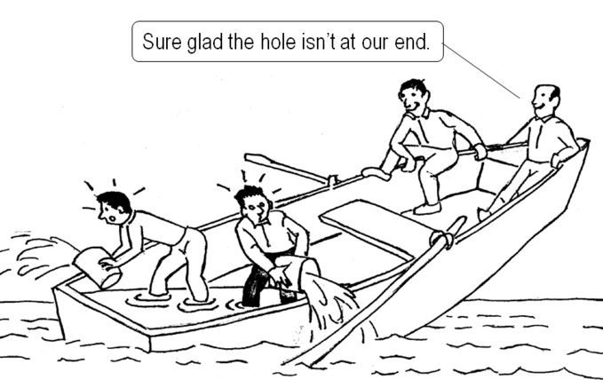

Organization: Building Disciplinary Bridges
Growing pressure/urgency
Cyber = general enterprise risk
Structured processes
Meshing discovery, model building/ validation, alerting/remediation
Data engineering as a process
Discovery / exploration
Detection / remediation

Slide 48
Key Prescribed Treatments: Correlation Between Factors
Challenge Themes (Factors) | Best Practice Themes (Factors)
1. Leadership has ‘lost the plot’ | Management-driven change Training & program governance
2. Can’t do it all! | Organizational process engineering Focused scientific processes
3. Between a rock and a hard place… (limits of rules vs. hype) | Architecture-driven solutions Semantic frameworks
4. Scientific contextualists | Training & program governance Data engineering practices
5. Data cleansing: ‘the ugly stepchild’ | Management-driven change Training & program governance Structured risk quantification Focused scientific processes Data engineering practices Semantic frameworks

Slide 49
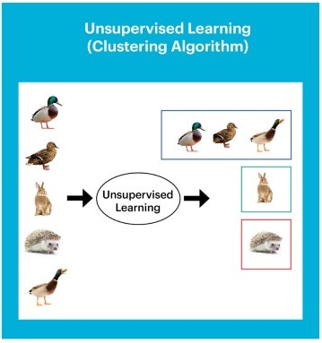
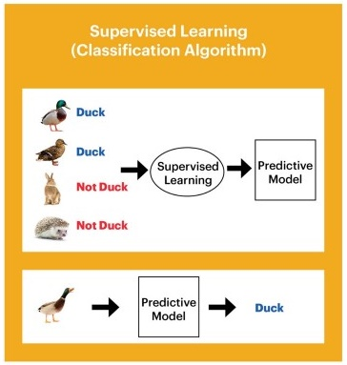
Process: Machine Learning Segmentation versus Classification
https://medium.com/datadriveninvestor/differences-between-ai-and-machine-learning-and-why-it-matters-1255b182fc6

Slide 50

Cybersecurity Analytics Maturity Model
Anomaly Detection
Data-aware Investigations
Predictive Detection
Risk Awareness /
Resource Optimization
Big data overload
Flags, rules, and alerts
Understanding
Feature engineering
Unsupervised ML
Labeling
Diagnostics
Learning
Human-in-the-loop reinforcement learning
Semi- and Supervised ML
Risk Optimal
Champion-challenger model management
Automating alert triage
Resource optimization
Chasing phantom patterns

Slide 51
Cyber Defense Economics: Optimizing Accessibility Versus Exposure Invest to point of optimality
SOURCE
Partnering for Cyber Resilience: Towards the Quantification of Cyber Threats
WEF report in collaboration with Deloitte: http://www3.weforum.org/docs/WEFUSA_QuantificationofCyberThreats_Report2015.pdf
51

Slide 52

The ‘Meta Picture’ for Technologists and Methodologists
Cybersecurity: hybrid techno-economic-behavioral context = many latent variables
Research methodology
Multivariate inferential statistics
Social science: grounded theory (inductive)
Cross-applicability to ‘core’ cybersecurity?
e.g. Increase in complex multi-domain models?
Extrapolating & validating patterns
Content analysis / text analytics
Cluster Analysis
Principal Component Analysis (PCA)
Discriminant Analysis
Factor Analysis* => latent factors
Correspondence Analysis
Structural equation modeling (SEM)
Extrapolating latent behavioral indicators
i.e. User IT ‘technical sophistication’
‘Organizational importance’ of a device
‘Adversarial determination’
Validating theoretical models

